Slide 1
Determinants
CRAMER’S RULE, VOLUME, AND LINEAR TRANSFORMATIONS

Slide 2
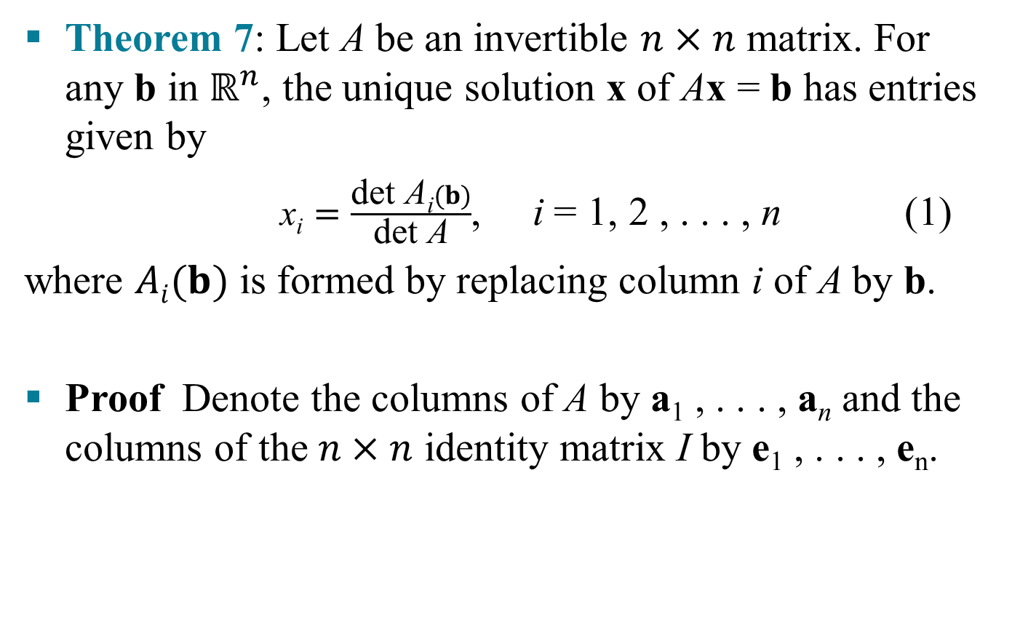
CRAMER’S RULE
Theorem 7: Let A be an invertible $n×n$ matrix. For any b in $ℝ^{n}$, the unique solution x of Ax = b has entries given by
$\text{x}\text{i}=\frac{\text{det} \text{A}\text{i}(b)}{\text{det} \text{A}}$, i = 1, 2 , . . . , n (1)
where $Ai(b)$ is formed by replacing column i of A by b.
Proof Denote the columns of A by a₁ , . . . , a_{n} and the columns of the $n×n$ identity matrix I by e₁ , . . . , e_{n}.

Slide 3
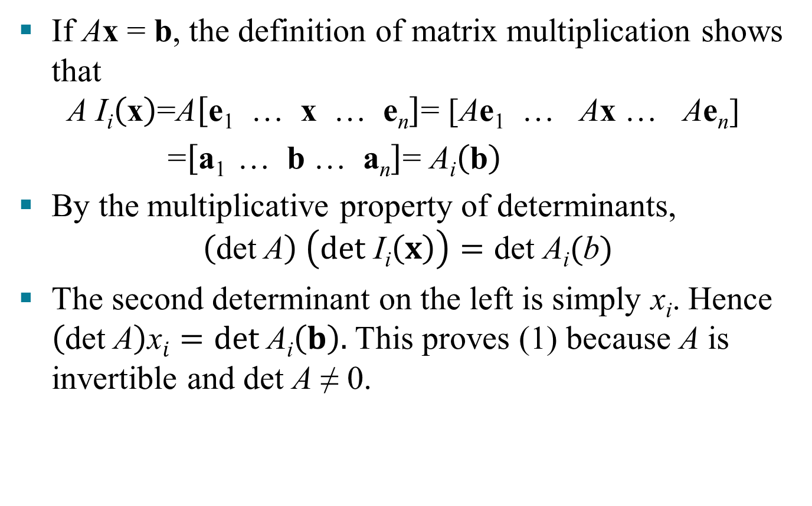
CRAMER’S RULE
If Ax = b, the definition of matrix multiplication shows that
$$\text{A} \text{I}\text{i}\left(\text{x}\right)\text{=}\text{A}\left[\text{e}\text{1 }\text{… }\text{x}\text{ … }\text{e}\text{n}\right]\text{=} \text{[}\text{A}\text{e}\text{1 }\text{… }\text{A}\text{x}\text{ … }\text{A}\text{e}\text{n}\text{] }$$
$\text{ =}\left[\text{a}\text{1 }\text{… }\text{b}\text{ … }\text{a}\text{n}\right]\text{=}$ $\text{A}\text{i}\left(\text{b}\right)$
By the multiplicative property of determinants,
$$\left(\text{det} \text{A}\right) \left(det \text{I}\text{i}\left(x\right)\right)=\text{det} \text{A}\text{i}(\text{b})$$
The second determinant on the left is simply x_{i}. Hence $\left(\text{det} \text{A}\right)\text{x}i=det \text{A}\text{i}\left(b\right).$ This proves (1) because A is invertible and det A ≠ 0.

Slide 4
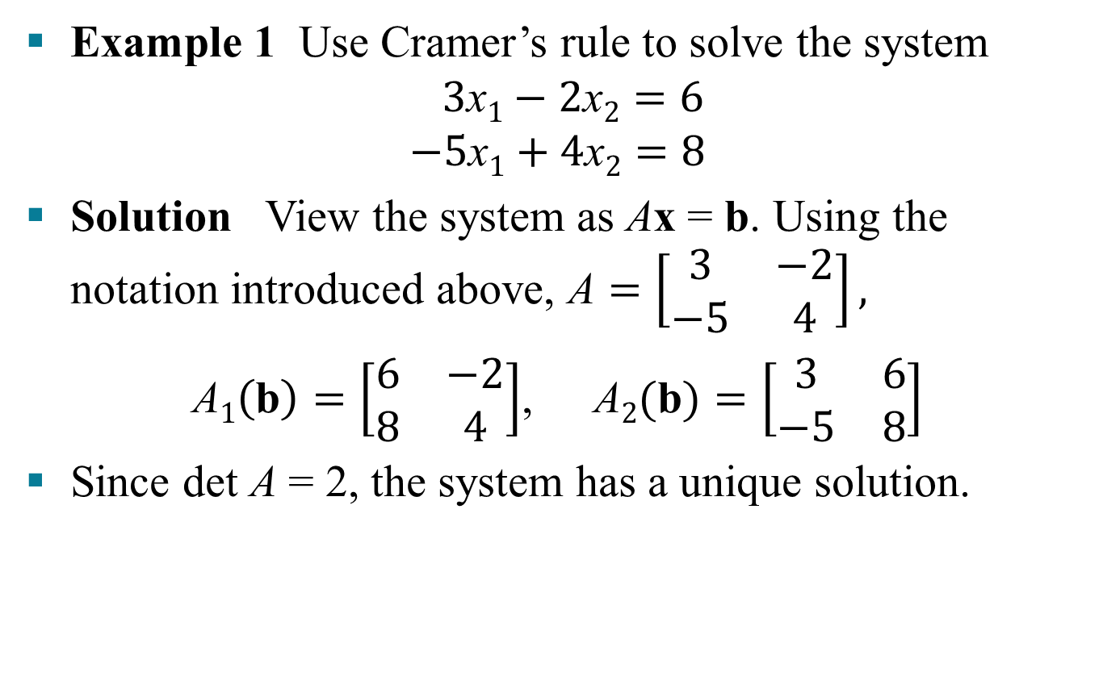
CRAMER’S RULE
Example 1 Use Cramer’s rule to solve the system
$$3\text{x}1−2\text{x}2=6$$
$$−5\text{x}1+4\text{x}2=8$$
Solution View the system as Ax = b. Using the notation introduced above, $\text{A}=\left[\begin{matrix}3 & −2 \\ −5 & 4\end{matrix}\right],$
$\text{A}1\left(\text{b}\right)=\left[\begin{matrix}6 & −2 \\ 8 & 4\end{matrix}\right]$,$\text{A}2(\text{b})=\left[\begin{matrix}3 & 6 \\ −5 & 8\end{matrix}\right]$
Since det A = 2, the system has a unique solution.

Slide 5

CRAMER’S RULE
By Cramer’s rule,
$$\text{x}1=\frac{\text{det} \text{A}1(\text{b})}{\text{det} \text{A}}=\frac{24+16}{2}=20$$
$$\text{x}2=\frac{\text{det} \text{A}2(\text{b})}{\text{det} \text{A}}=\frac{24+30}{2}=27$$

Slide 6

A FORMULA FOR A^{–1}
The adjugate matrix is the transpose of the matrix of cofactors.
Theorem 8: Let A be an invertible $\text{n}×\text{n}$ matrix. Then
$${\text{A}}^{−1}=\frac{1}{\text{det} \text{A}}\text{adj} \text{A}$$

Slide 7
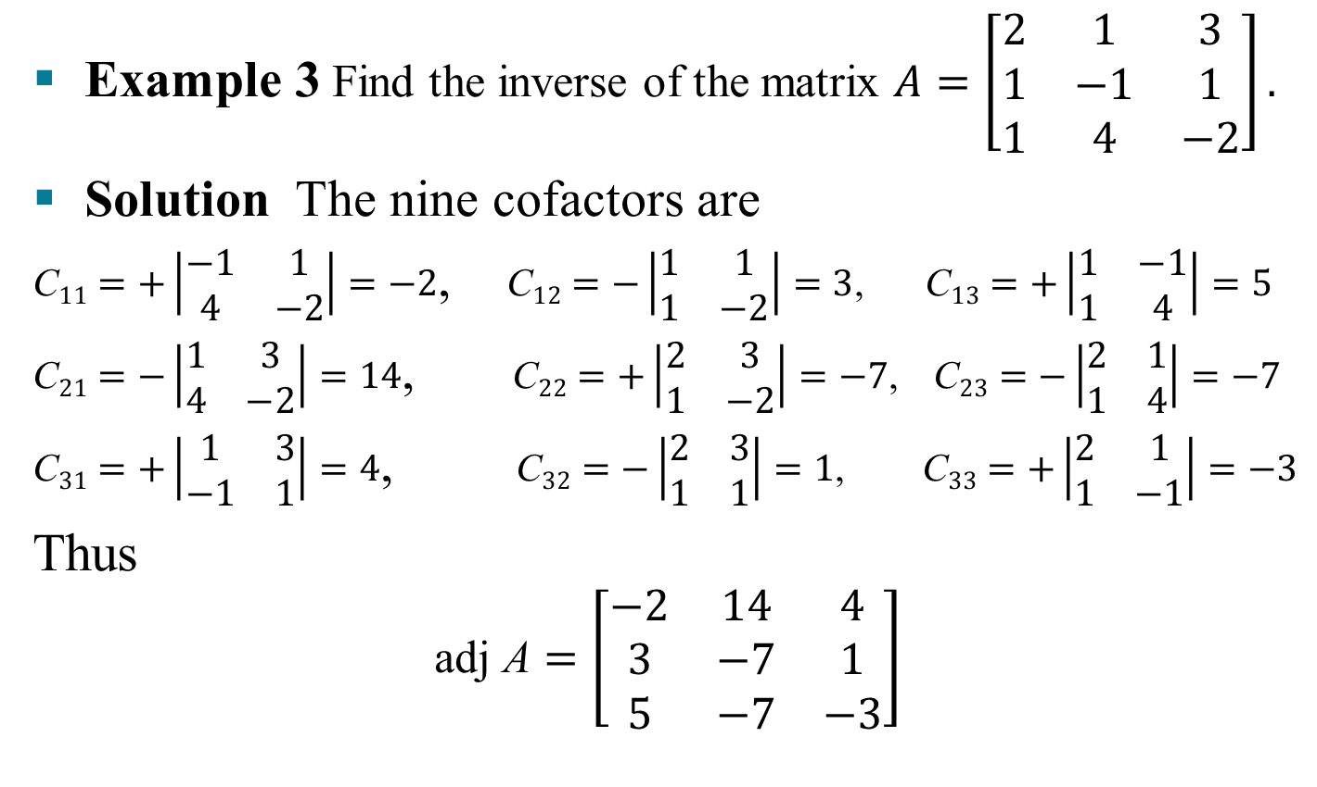
A FORMULA FOR A^{–1}
Example 3 Find the inverse of the matrix $A=\left[\begin{matrix}2 & 1 & 3 \\ 1 & −1 & 1 \\ 1 & 4 & −2\end{matrix}\right].$
Solution The nine cofactors are
$\text{C}11=+\left|\begin{matrix}−1 & 1 \\ 4 & −2\end{matrix}\right|=−2$, $\text{C}12=−\left|\begin{matrix}1 & 1 \\ 1 & −2\end{matrix}\right|=3$, $\text{C}13=+\left|\begin{matrix}1 & −1 \\ 1 & 4\end{matrix}\right|=5$
$\text{C}21=−\left|\begin{matrix}1 & 3 \\ 4 & −2\end{matrix}\right|=14$, $\text{C}22=+\left|\begin{matrix}2 & 3 \\ 1 & −2\end{matrix}\right|=−7$, $\text{C}23=−\left|\begin{matrix}2 & 1 \\ 1 & 4\end{matrix}\right|=−7$
$\text{C}31=+\left|\begin{matrix}1 & 3 \\ −1 & 1\end{matrix}\right|=4$, $\text{C}32=−\left|\begin{matrix}2 & 3 \\ 1 & 1\end{matrix}\right|=1$, $\text{C}33=+\left|\begin{matrix}2 & 1 \\ 1 & −1\end{matrix}\right|=−3$
Thus
$$\text{adj} \text{A}=\left[\begin{matrix}−2 & 14 & 4 \\ 3 & −7 & 1 \\ 5 & −7 & −3\end{matrix}\right]$$

Slide 8
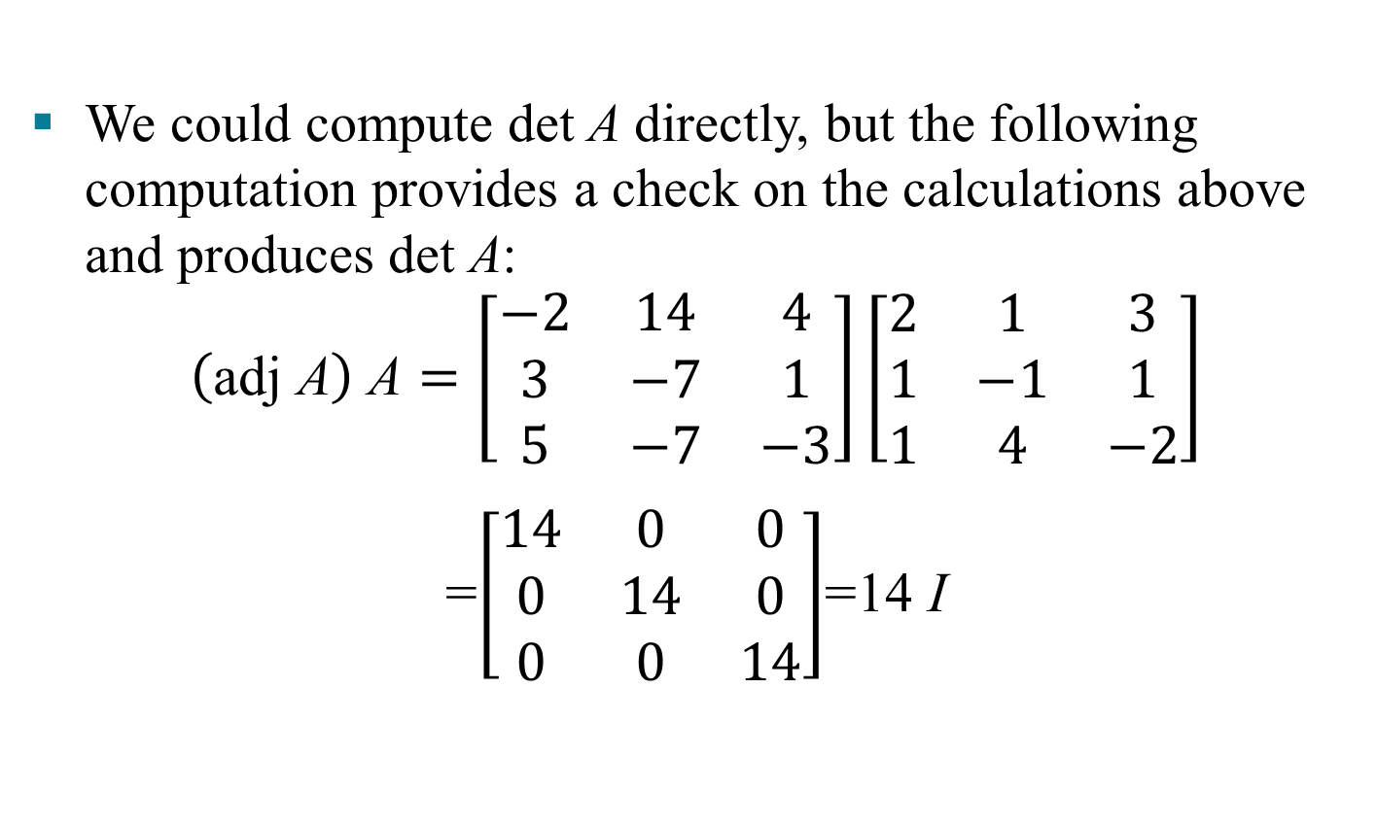
A FORMULA FOR A^{–1}
We could compute det A directly, but the following computation provides a check on the calculations above and produces det A:
$$\left(\text{adj} \text{A}\right) \text{A}=\left[\begin{matrix}−2 & 14 & 4 \\ 3 & −7 & 1 \\ 5 & −7 & −3\end{matrix}\right]\left[\begin{matrix}2 & 1 & 3 \\ 1 & −1 & 1 \\ 1 & 4 & −2\end{matrix}\right]$$
=$\left[\begin{matrix}14 & 0 & 0 \\ 0 & 14 & 0 \\ 0 & 0 & 14\end{matrix}\right]$=14 I

Slide 9
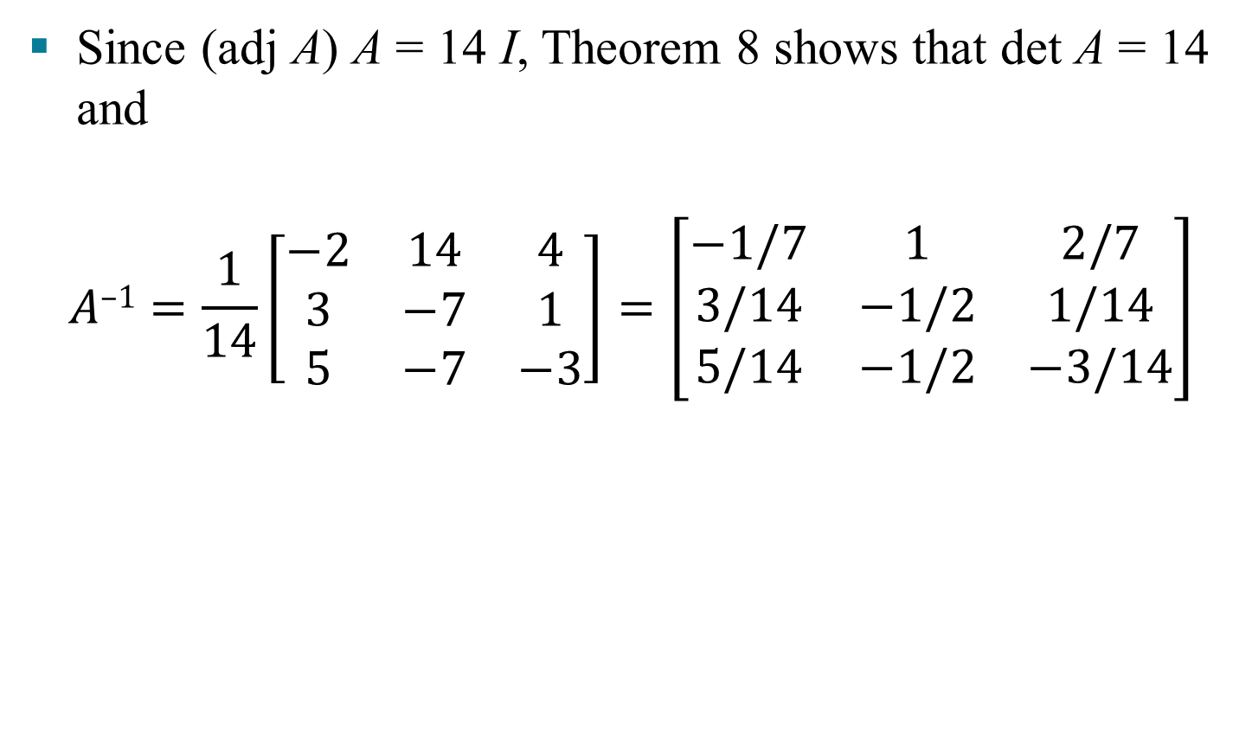
A FORMULA FOR A^{–1}
Since (adj A) A = 14 I, Theorem 8 shows that det A = 14 and
$$A\text{–}\text{1}=\frac{1}{14}\left[\begin{matrix}−2 & 14 & 4 \\ 3 & −7 & 1 \\ 5 & −7 & −3\end{matrix}\right]=\left[\begin{matrix}−1/7 & 1 & 2/7 \\ 3/14 & −1/2 & 1/14 \\ 5/14 & −1/2 & −3/14\end{matrix}\right]$$

Slide 10
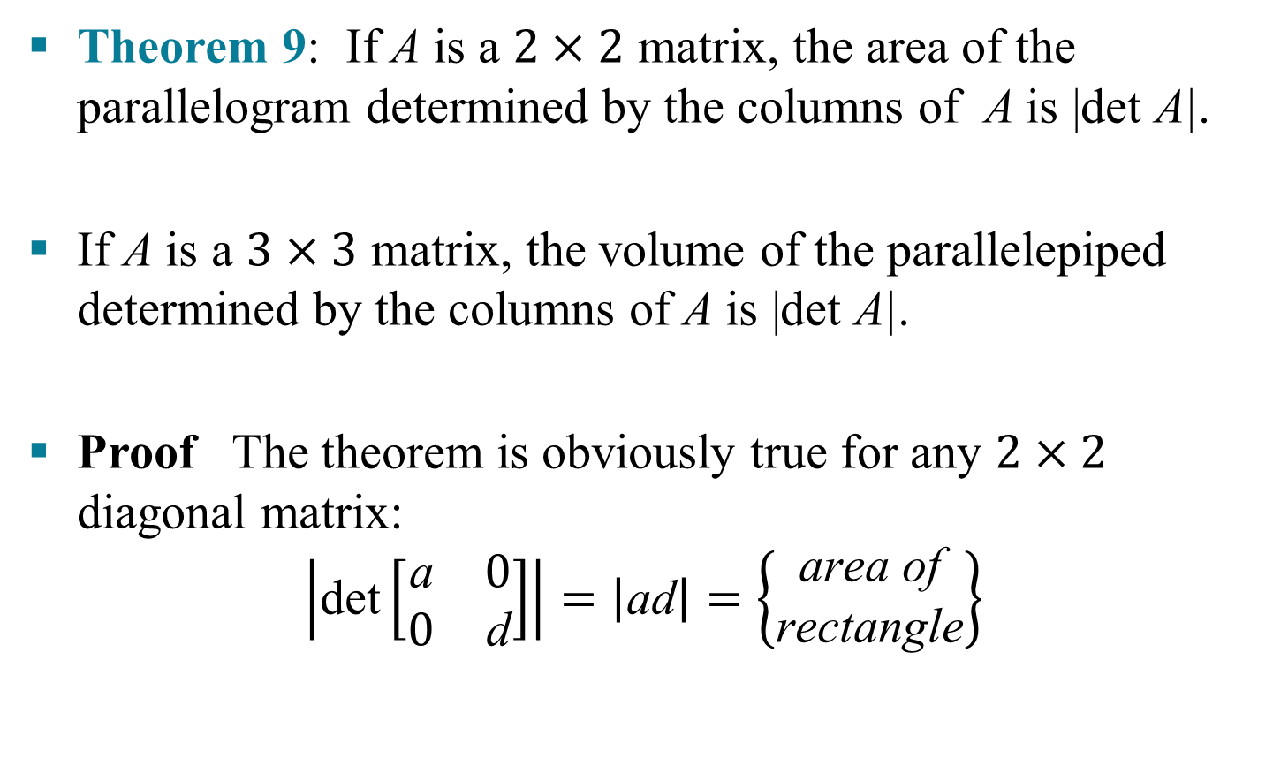
DETERMINANTS AS AREA OR VOLUME
Theorem 9: If A is a $2×2$ matrix, the area of the parallelogram determined by the columns of A is |det A|.
If A is a $3×3$ matrix, the volume of the parallelepiped determined by the columns of A is |det A|.
Proof The theorem is obviously true for any $2×2$ diagonal matrix:
$$\left|\text{det}\left[\begin{matrix}\text{a} & 0 \\ 0 & \text{d}\end{matrix}\right]\right|=\left|\text{ad}\right|=\left\{\begin{aligned}\text{area} \text{of} \\ \text{rectangle}\end{aligned}\right\}$$

Slide 11
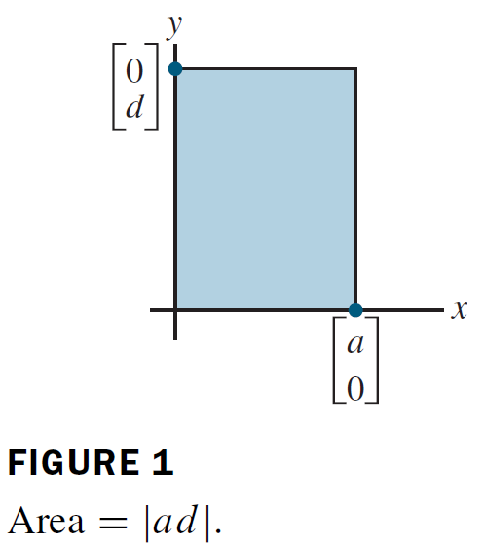

DETERMINANTS AS AREA OR VOLUME
It will suffice to show that any 2 $×$ 2 matrix A = [a₁ a₂] can be transformed into a diagonal matrix in a way that changes neither the area of the associated parallelogram nor |det A|.

Slide 12
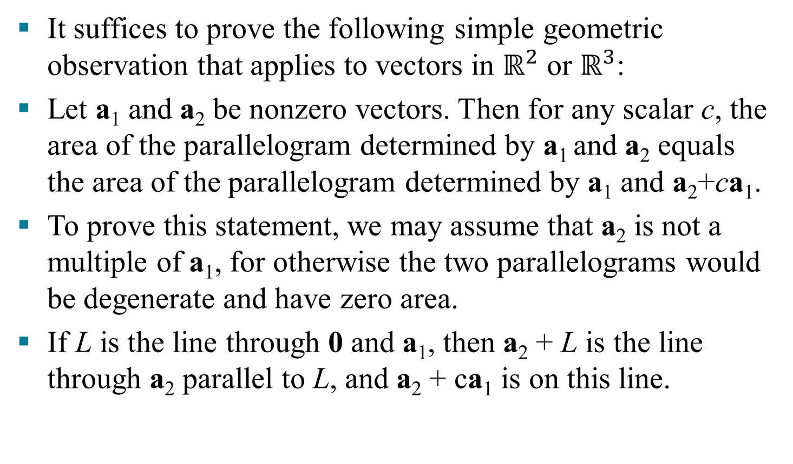
DETERMINANTS AS AREA OR VOLUME
It suffices to prove the following simple geometric observation that applies to vectors in $ℝ^{2}$ or $ℝ^{3}$:
Let a₁ and a₂ be nonzero vectors. Then for any scalar c, the area of the parallelogram determined by a₁ and a₂ equals the area of the parallelogram determined by a₁ and a₂+ca₁.
To prove this statement, we may assume that a₂ is not a multiple of a₁, for otherwise the two parallelograms would be degenerate and have zero area.
If L is the line through 0 and a₁, then a₂ + L is the line through a₂ parallel to L, and a₂ + ca₁ is on this line.

Slide 13
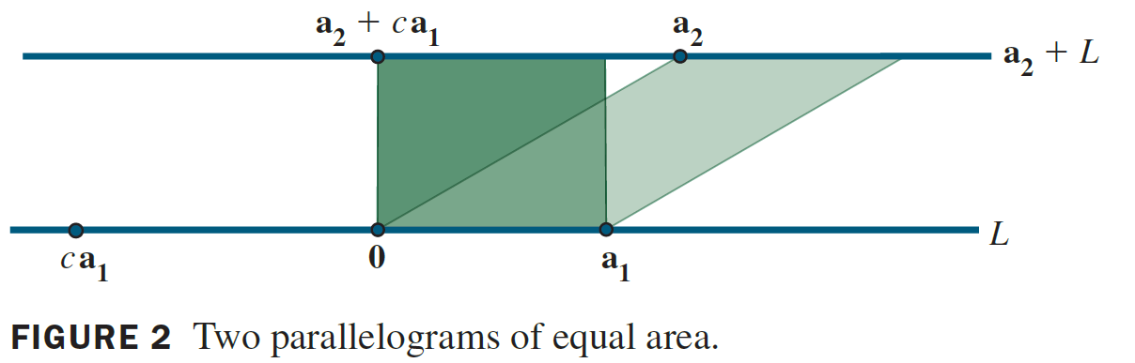
DETERMINANTS AS AREA OR VOLUME
The points a₂ and a₂ + ca₁ have the same perpendicular distance to L. Hence the two parallelograms have the same area, since they share the base from 0 to a₁.

Slide 14
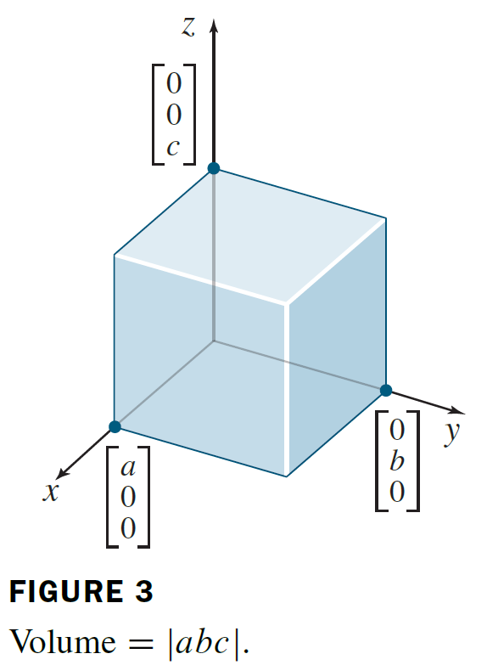

DETERMINANTS AS AREA OR VOLUME
The proof for $ℝ^{3}$ is similar. The theorem is obviously true for a 3$×$ 3 diagonal matrix.

Slide 15
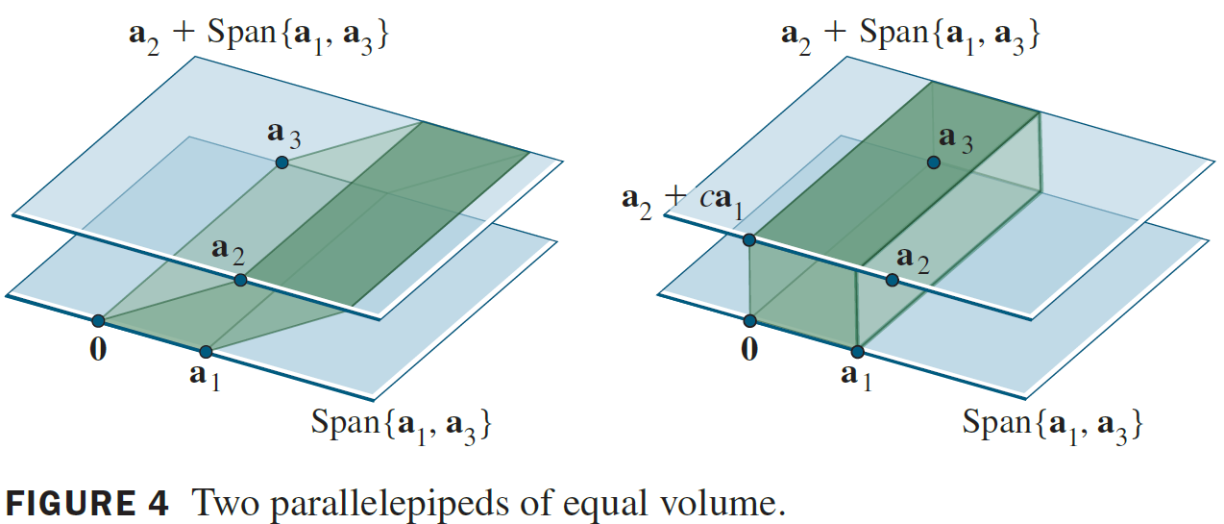

DETERMINANTS AS AREA OR VOLUME
And any 3$×$3 matrix A can be transformed into a diagonal matrix using column operations that do not change |det A|.
A parallelepiped is shown below as a shaded box with two sloping sides.

Slide 16
DETERMINANTS AS AREA OR VOLUME
Its volume is the area of the base in the plane Span{a₁, a₃} times the altitude of a₂ above Span{a₁, a₃}. Any vector a₂ + ca₁ lies in the plane Span{a₁, a₃}, which is parallel to Span{a₁, a₃}.
Hence the volume of the parallelepiped is unchanged when [a₁ a₂ a₃] is changed to [a₁ a₂ +ca₁ a₃].
Thus a column replacement operation does not affect the volume of the parallelepiped. Since the column interchanges have no effect on the volume, the proof is complete.

Slide 17
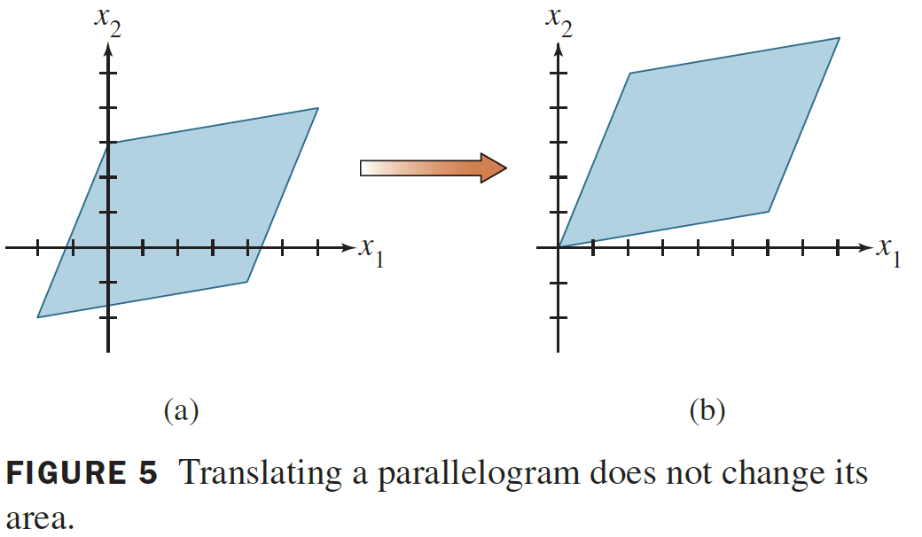
DETERMINANTS AS AREA OR VOLUME
Example 4 Calculate the area of the parallelogram determined by the points (-2, -2), (0, 3), (4, -1), and (6, 4).

Slide 18
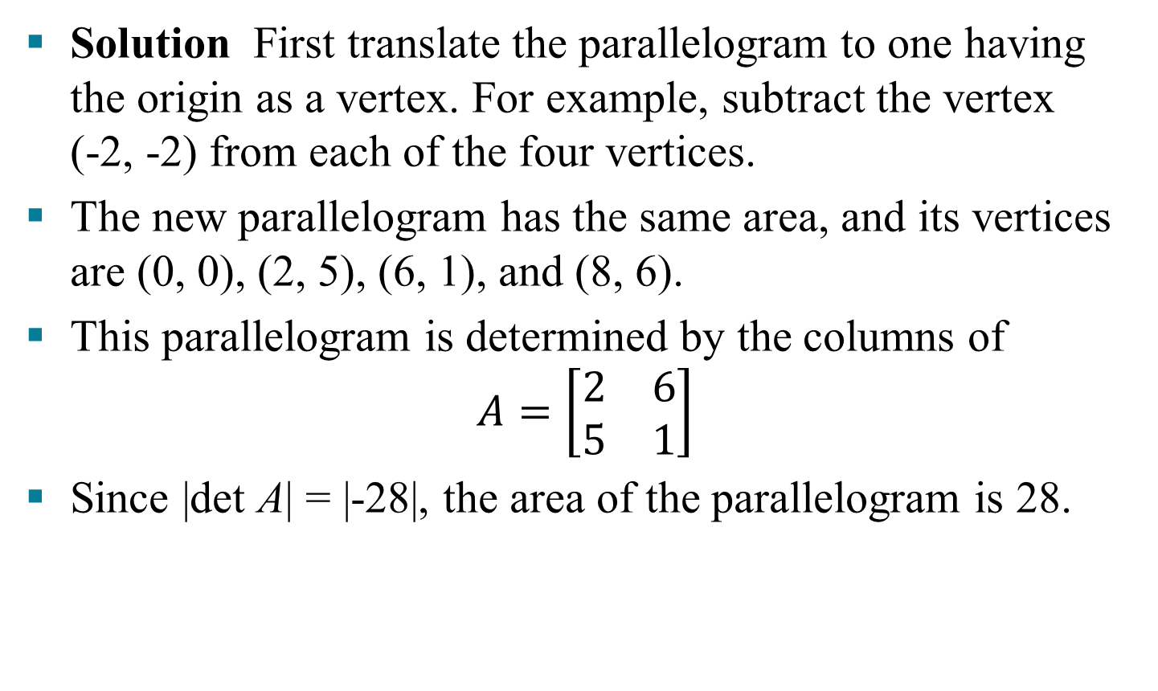
DETERMINANTS AS AREA OR VOLUME
Solution First translate the parallelogram to one having the origin as a vertex. For example, subtract the vertex (-2, -2) from each of the four vertices.
The new parallelogram has the same area, and its vertices are (0, 0), (2, 5), (6, 1), and (8, 6).
This parallelogram is determined by the columns of
$$A=\left[\begin{matrix}2 & 6 \\ 5 & 1\end{matrix}\right]$$
Since |det A| = |-28|, the area of the parallelogram is 28.

Slide 19
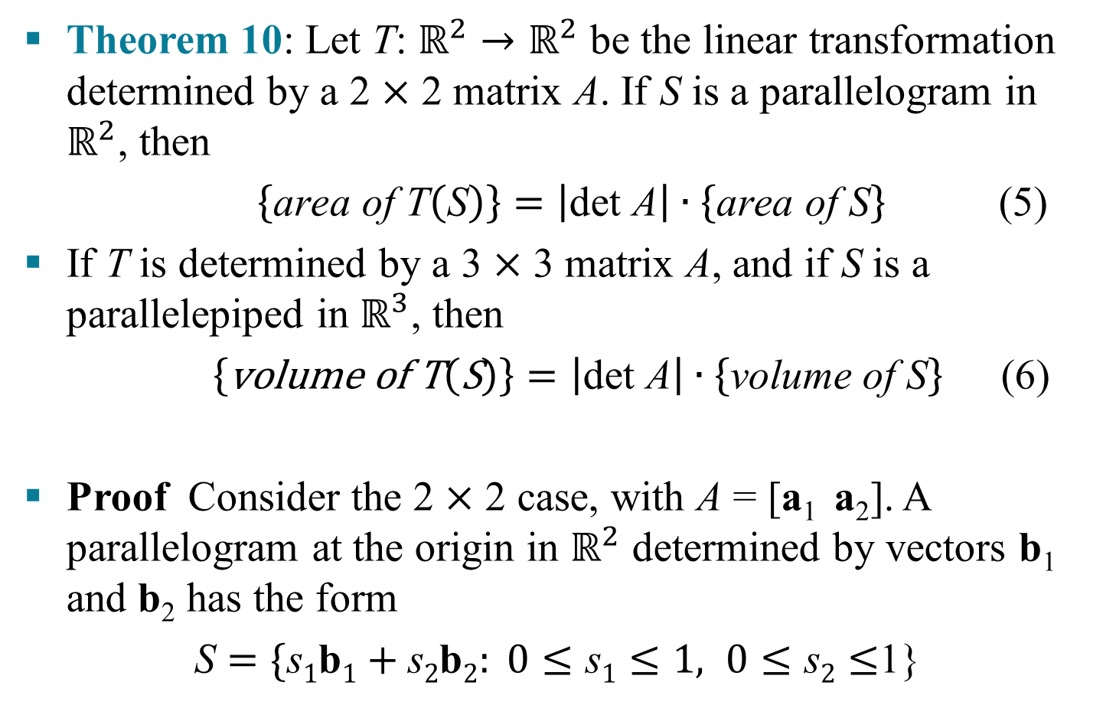
LINEAR TRANSFORMATIONS
Theorem 10: Let T: $ℝ^{2}→ℝ^{2}$ be the linear transformation determined by a 2 $×$ 2 matrix A. If S is a parallelogram in $ℝ^{2}$, then
$\left\{\text{area} \text{of} \text{T}\left(\text{S}\right)\right\}=\left|\text{det} \text{A}\right|∙\left\{\text{area} \text{of} \text{S}\right\}$ (5)
If T is determined by a 3 $×$ 3 matrix A, and if S is a parallelepiped in $ℝ^{3}$, then
$\left\{\text{volume} \text{of} \text{T}\left(\text{S}\right)\right\}=\left|\text{det} \text{A}\right|∙\left\{\text{volume} \text{of} \text{S}\right\}$ (6)
Proof Consider the 2 $×$ 2 case, with A = [a₁ a₂]. A parallelogram at the origin in $ℝ^{2}$ determined by vectors b₁ and b₂ has the form
$\text{S}=\{\text{s}1\text{b}1+\text{s}2\text{b}2: 0≤\text{s}1≤1, 0≤\text{s}2≤$1}

Slide 20
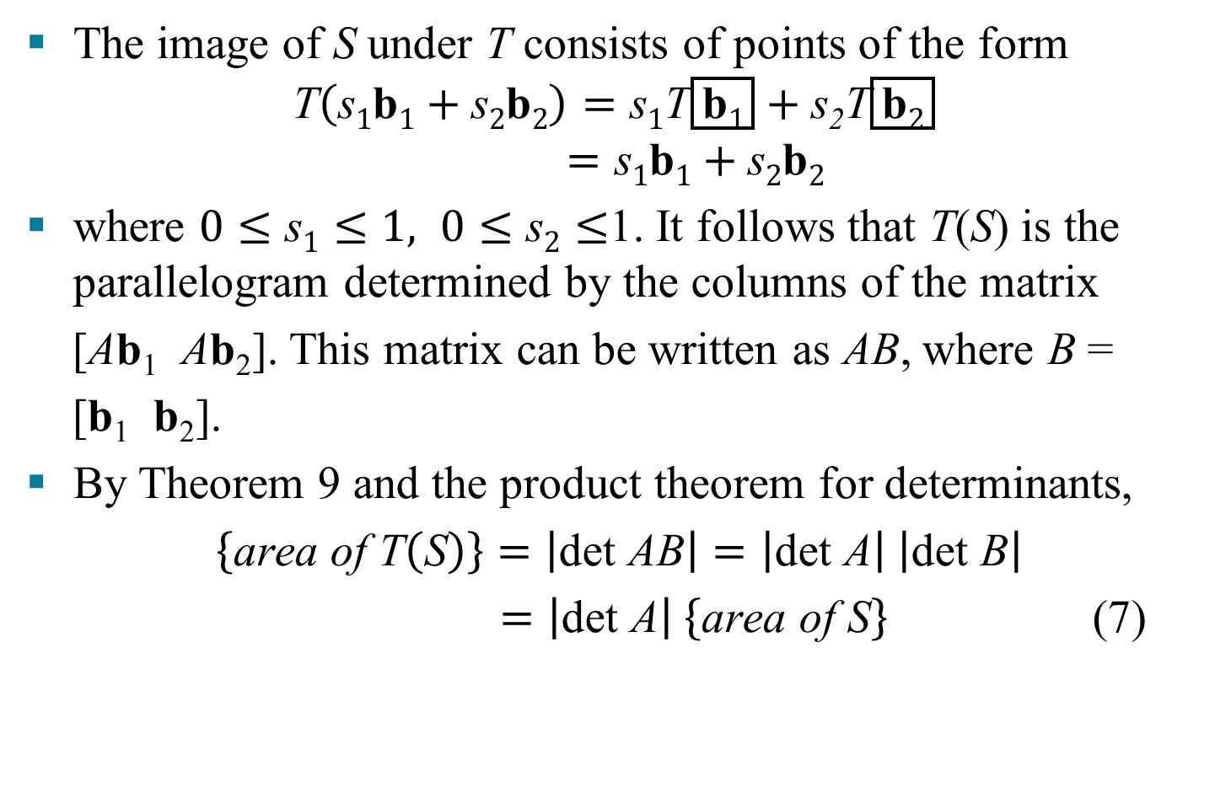
LINEAR TRANSFORMATIONS
The image of S under T consists of points of the form
$$\text{T}\left(\text{s}1\text{b}1+\text{s}2\text{b}2\right)=\text{s}1\text{T}\left(\text{b}1\right)+\text{s}\text{2}\text{T}\left(\text{b}2\right)$$
$$=\text{s}1\text{b}1+\text{s}2\text{b}2$$
where $0≤\text{s}1≤1, 0≤\text{s}2≤$1. It follows that T(S) is the parallelogram determined by the columns of the matrix
[Ab₁ Ab₂]. This matrix can be written as AB, where B =
[b₁ b₂].
By Theorem 9 and the product theorem for determinants,
$\left\{\text{area} \text{of} \text{T}\left(\text{S}\right)\right\}=\left|\text{det} \text{A}\text{B}\right|=\left|\text{det} \text{A}\right| \left|\text{det} \text{B}\right|$
$=\left|\text{det} \text{A}\right| \left\{\text{area} \text{of} \text{S}\right\}$ (7)

Slide 21
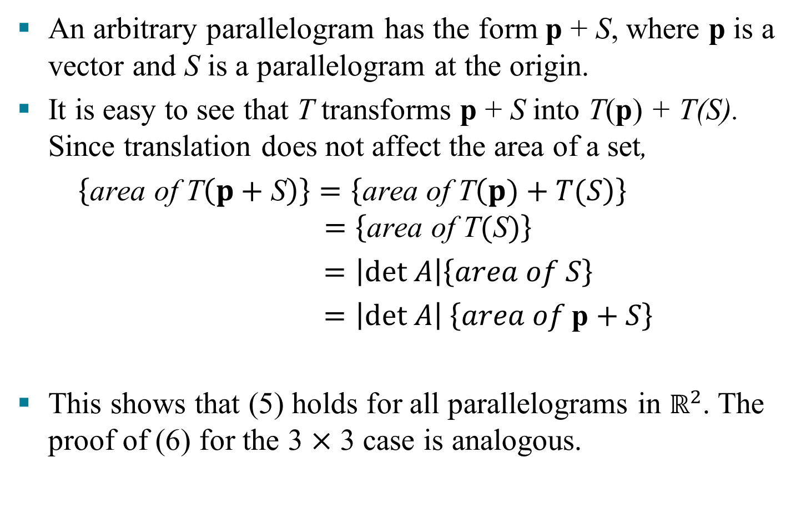
LINEAR TRANSFORMATIONS
An arbitrary parallelogram has the form p + S, where p is a vector and S is a parallelogram at the origin.
It is easy to see that T transforms p + S into T(p) + T(S). Since translation does not affect the area of a set,
$\left\{\text{area} \text{of} \text{T}\left(p+\text{S}\right)\right\}=\left\{\text{area} \text{of} \text{T}\left(p)+T(S\right)\right\}$
$$=\left\{\text{area} \text{of} \text{T}(\text{S})\right\}$$
$=\left|det A\right|\left\{area of S\right\}$
$=\left|det A\right| \left\{area of \text{p}\text{ + }S\right\}$
This shows that (5) holds for all parallelograms in $ℝ^{2}$. The proof of (6) for the 3 $×$ 3 case is analogous.
Translation
By equation (7)
Translation

Slide 22
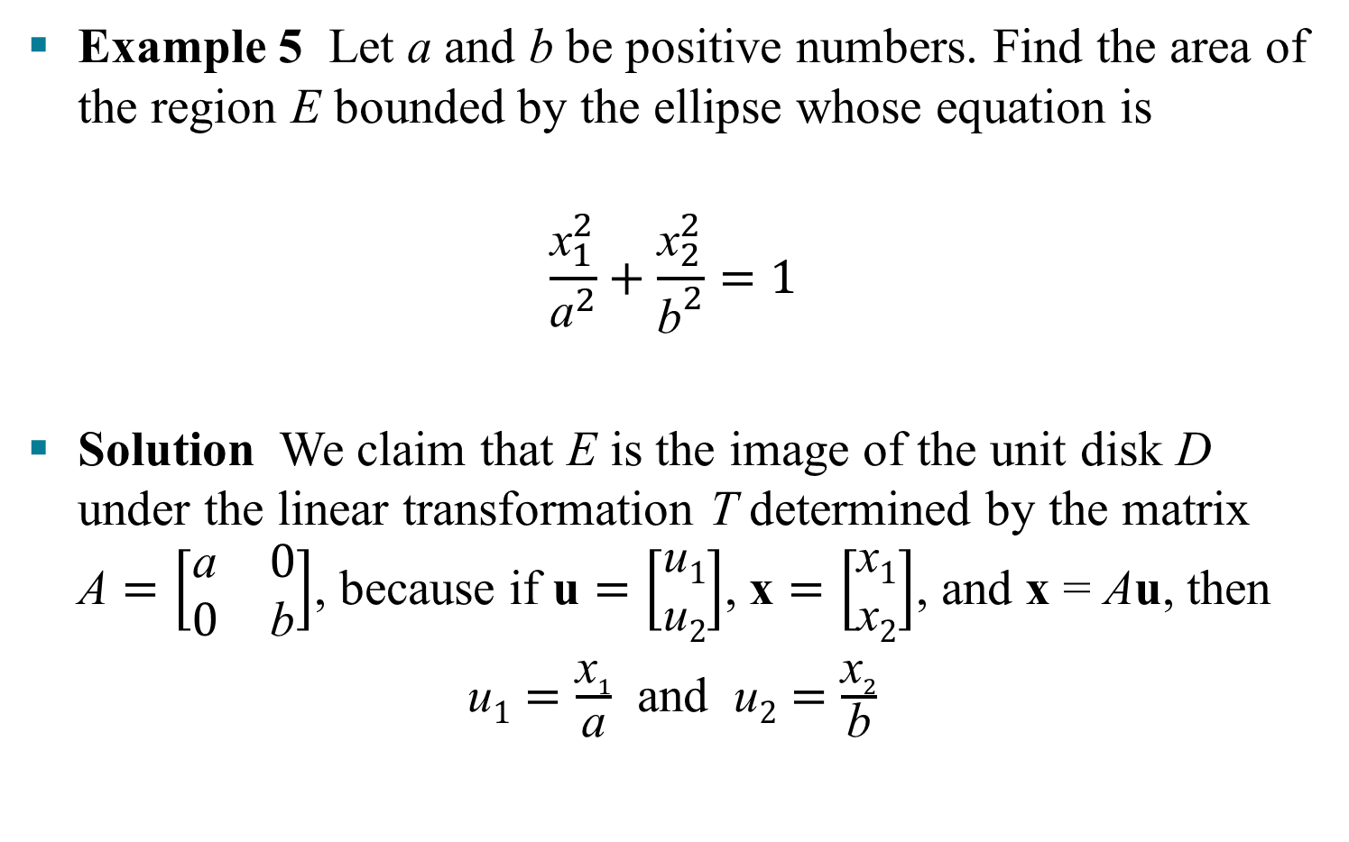
LINEAR TRANSFORMATIONS
Example 5 Let a and b be positive numbers. Find the area of the region E bounded by the ellipse whose equation is
$$\frac{{\text{x}}_{1}^{2}}{{\text{a}}^{2}}+\frac{{\text{x}}_{2}^{2}}{{\text{b}}^{2}}=1$$
Solution We claim that E is the image of the unit disk D under the linear transformation T determined by the matrix $\text{A}=\left[\begin{matrix}\text{a} & 0 \\ 0 & \text{b}\end{matrix}\right]$, because if $\text{u}=\left[\begin{aligned}\text{u}1 \\ \text{u}2\end{aligned}\right]$, $\text{x}=\left[\begin{aligned}\text{x}1 \\ \text{x}2\end{aligned}\right]$, and x = Au, then
$\text{u}1=\frac{\text{x}1}{\text{a}}$ and $\text{u}2=\frac{\text{x}2}{\text{b}}$

Slide 23
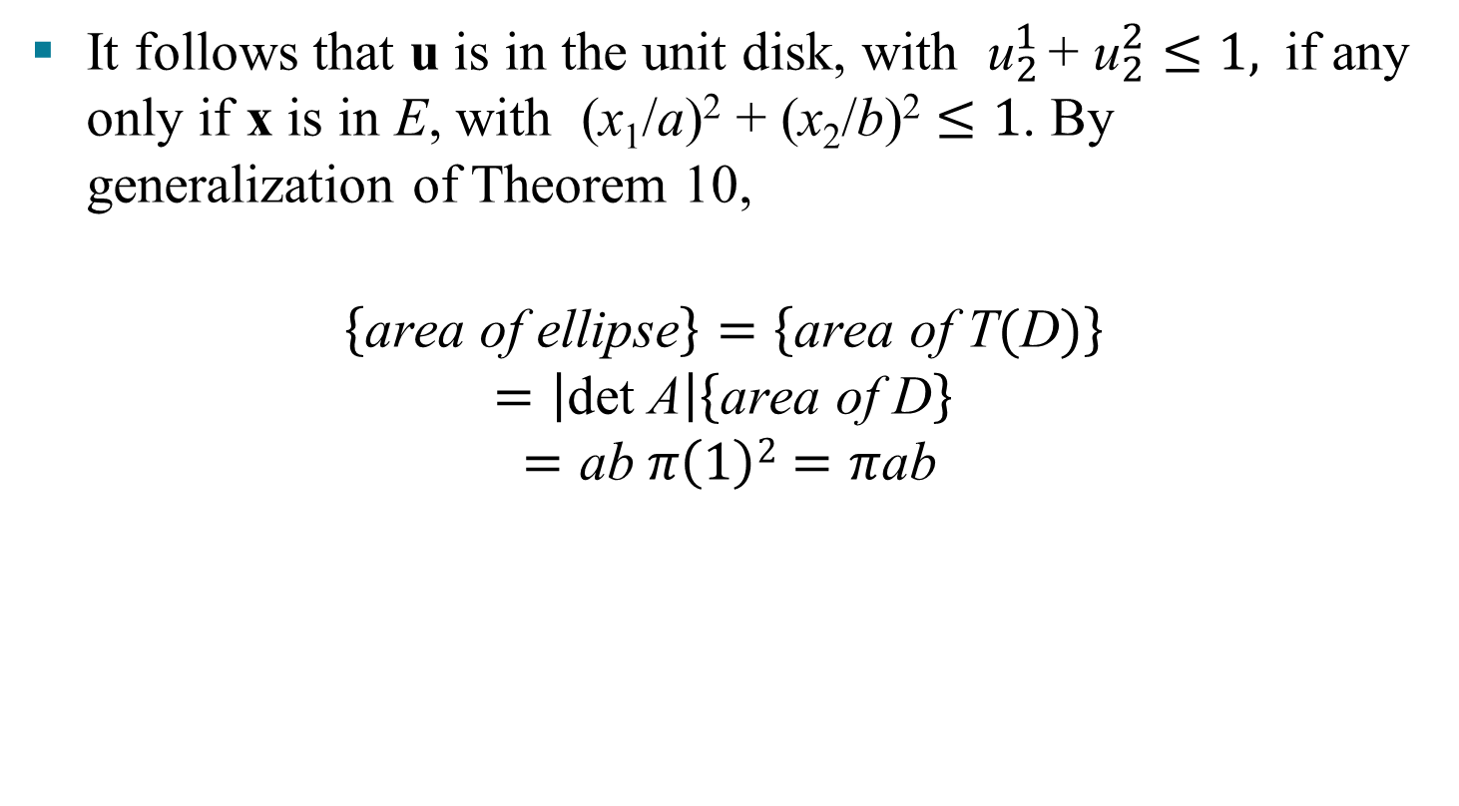
LINEAR TRANSFORMATIONS
It follows that u is in the unit disk, with ${\text{u}}_{2}^{1 }$+ ${\text{u}}_{2}^{2}≤1,$if any only if x is in E, with (x₁/a)² + (x₂/b)² $≤1$. By generalization of Theorem 10,
$$\left\{\text{area} \text{of} \text{ellipse}\right\}=\left\{\text{area} \text{of} \text{T}(\text{D})\right\}$$
$$=\left|\text{det} \text{A}\right|\left\{\text{area} \text{of} \text{D}\right\}$$
$$=\text{ab} π\left(1\right)2=π\text{ab}$$

